Slide 1



C6. Video Analysis
Module Project: Human action recognition
TEAM 5
Marcos Frías · Àngel Herrero · Francisco A. Molina · Rosana Valero

Slide 2
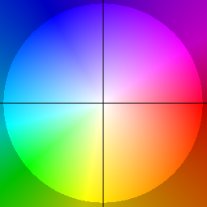
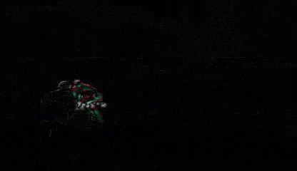

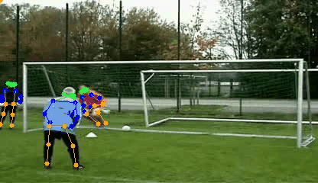
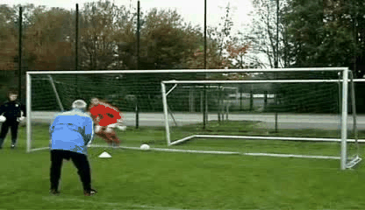
Alternative modality · Optical Flow
Task 1
Presented by:
Àngel
Team 5
Decision in favour of OF
Complexity.
RGB frame-diff clip
Optical flow (OF) clip
Skeletons clip
Works with 3D networks.
Works with 3D networks.
Efficient data.
Only highlights action.
Adds temporal information.
Different network.
Inefficient data.
Prior knowledge.
Multiple persons & actions (here throw, jump & stand)
Inefficient data.
Reference clip
Reference class: jump
Chosen modality

Slide 3
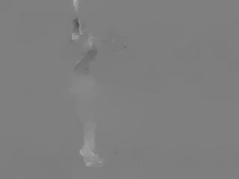
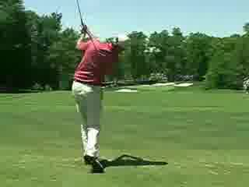
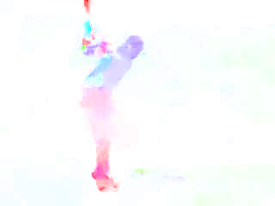
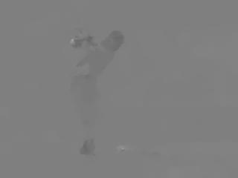
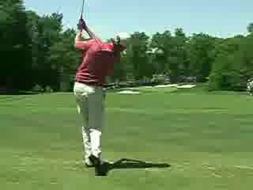
Alternative modality · Optical Flow
Task 1
Presented by:
Àngel
Team 5
OF obtaining pipeline
Downloaded OF^{[1]}
Our post-processing
OF in x direction
Frames of reference
frame 00048
OF in y direction
frame 00049
Using Dual TV-L1 algorithm.^{[2]}
Analyzes each pixel’s motion to provide both horizontal and vertical components.
Fusionate both components in HSV hue-based OF image.
As in W3.
[1] https://github.com/gianscuri/Action_Recognition_Two_Stream_HMDB51
[2] Sánchez Pérez, Meinhardt-Llopis, and Facciolo, “TV-L1 Optical Flow Estimation.” https://www.ipol.im/pub/art/2013/26/article_lr.pdf

Slide 4
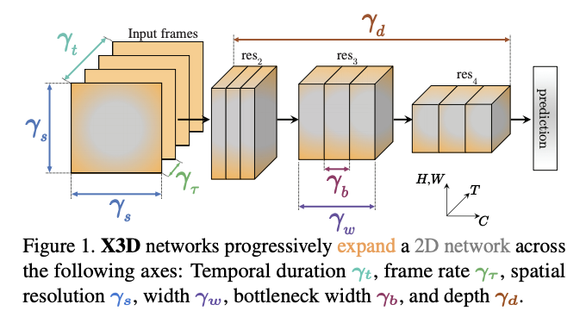
Alternative modality · Optical Flow
Task 1
Presented by:
Àngel
Team 5
OF action recognition tuning
Architecture: The x3D models’ family^{[3]}
 | Pretraining | TSN-K | Test Accuracy | Parameters (M) | FLOPs (G)
ResNet50 | No | 5 | 2.39% | 23.6
x3D-s | No | 5 | 10.48% | 3.1 | 3
x3D-s | Yes | 1 | 40.41% | 3.1 | 3
x3D-s | Yes | 5 | 41.13% | 3.1 | 3
BEST!
^{[3]}
Parameters
Discussion:
Using Pre-training weights really helps the model learning. Even though they are trained for RGB images.
The OF temporal information is not able to supply the fact of using a whole clip, as we can see when using the ResNet50.
Batch Size: 2
Learning rate: 0.0001
Temporal stride: 12
Clip length: 4
Optimizer: Adam
[3] Christoph Feichtenhofer, “X3D: Expanding Architectures for Efficient Video Recognition.” https://doi.org/10.48550/arXiv.2004.04730
Notes:
The x3D models’ family^{[3]} are a group of architectures that progressively expand a reduced 2D image classification network along multiple network axes to find the most efficient configuration. The main difference the x3D-xs and the x3D-s is that the latest includes more expansion steps together with a finally contraction step to ensure the lower GFLOPs number.

Slide 5
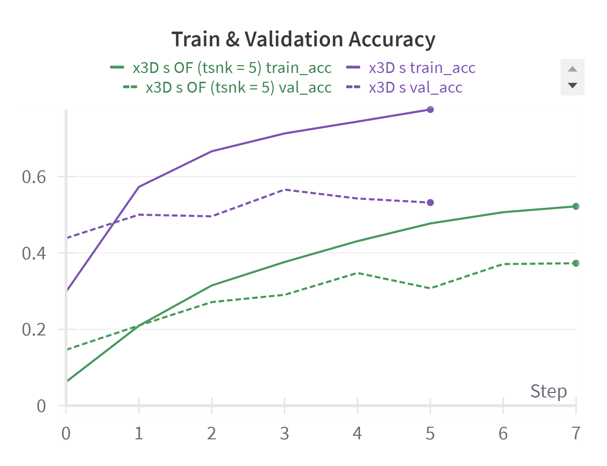
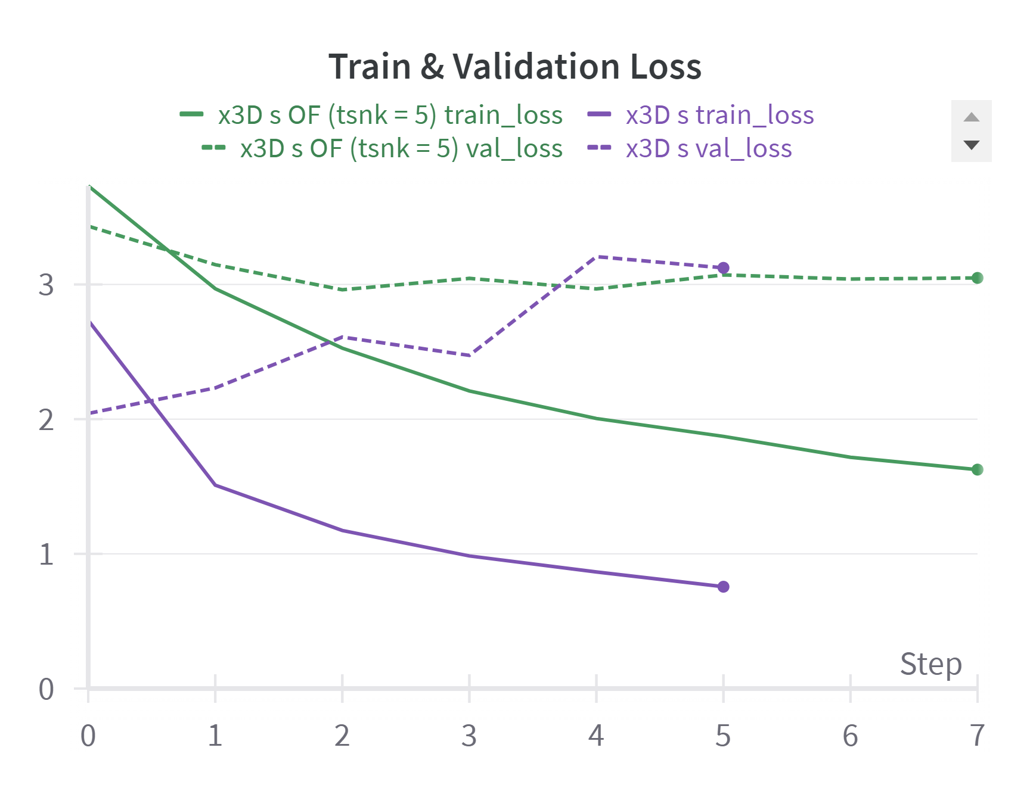
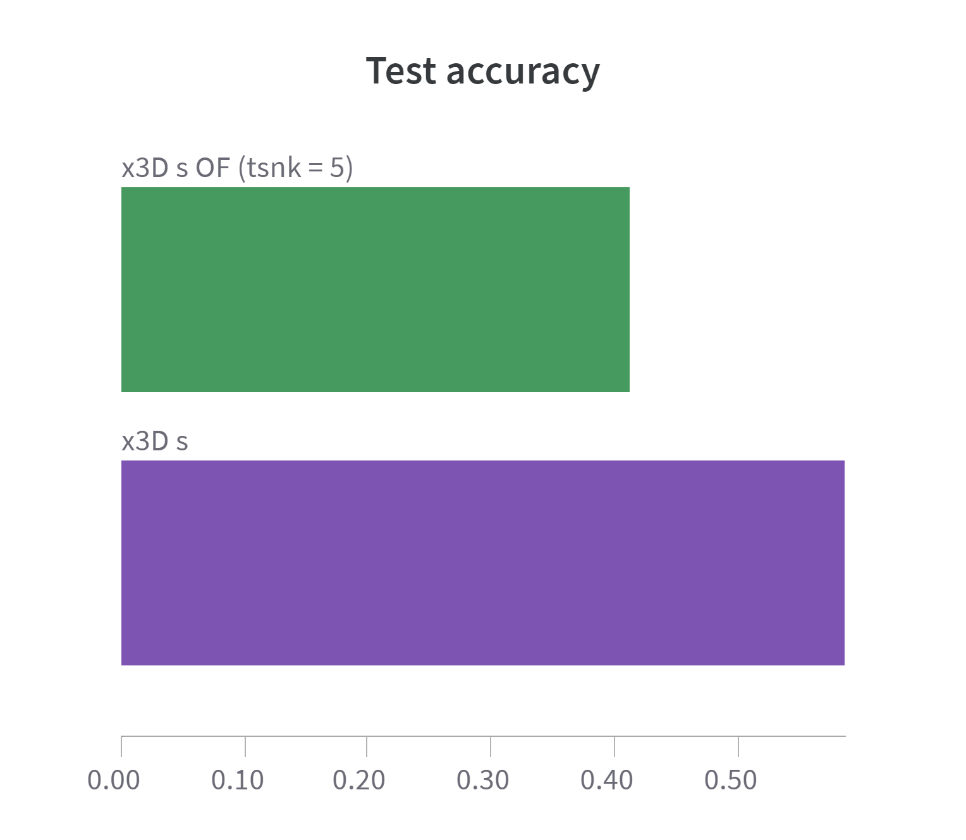
Alternative modality · Optical Flow
Task 1
Presented by:
Rosana
Team 5
OF action recognition results
0.41
0.59
Discussion:
Using RGB images results in a better human action recognition performance than using OF as alternative modality.
RGB images presents higher overfitting.
OF by itself can be satisfactorily used as human action indicator.

Slide 6
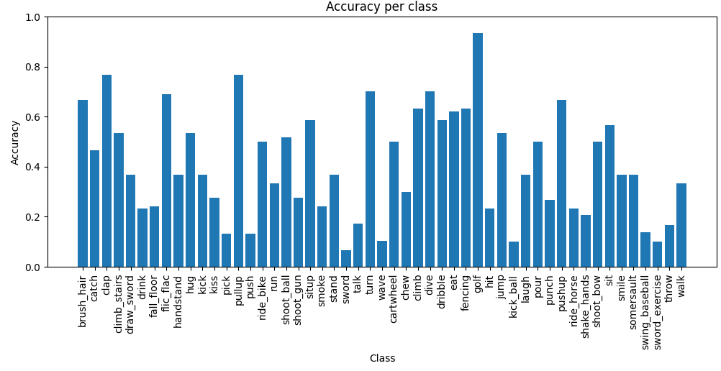
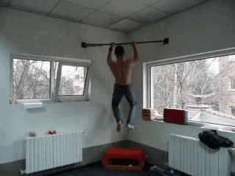
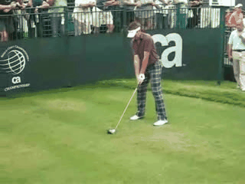
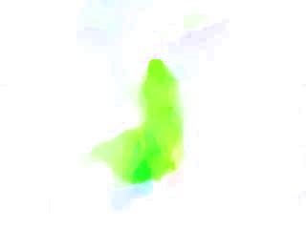

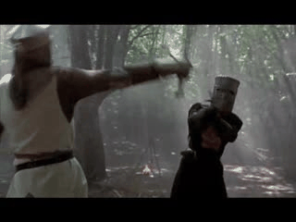
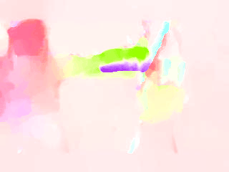
Alternative modality · Optical Flow
Task 1
Presented by:
Rosana
Team 5
OF action recognition accuracies
pull up
golf
sword
Repetitive movement
Specific movement
Multiple movements in multiple directions

Slide 7
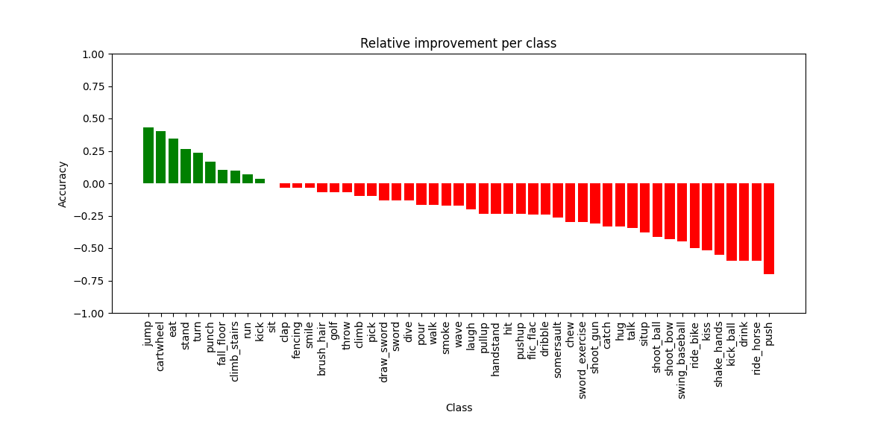
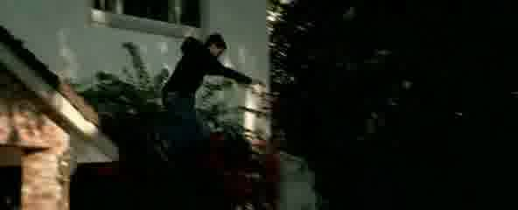
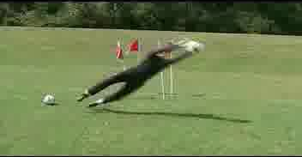
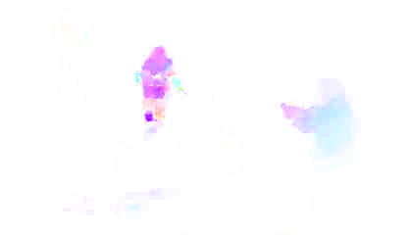
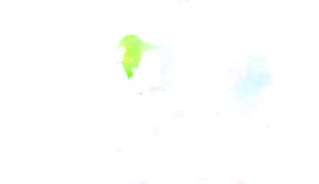
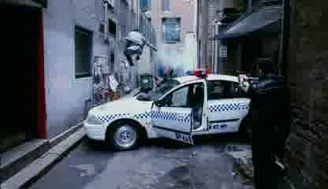
Alternative modality · Comparison
Task 1
Presented by:
Marcos
Team 5
Relative improvement per class with respect to RGB^{W6}
Positive Impact on Certain Actions by using Optical Flow
Dynamic Motion Patterns
Spatial-Temporal Relationships
Consistency in Motion Direction
Videos with very different contexts
Positive example: jump
RGB frames
OF frames
Different contexts
First frames
Last frames
Notes:
Positive Impact on Certain Actions by using Optical Flow
Dynamic Motion Patterns: Classes like jump, cartwheel and punch involved rapid and dynamic motion patterns which are well-captured by optical flow
Spatial-Temporal Relationships: Actions such as turn and eat may involve spatial-temporal relationships that are better represented by optical flow features
Consistency in Motion Direction: Actions that involve consistent motion directions, such as punch or cartwheel, may benefit from optical flow’s ability to highlight directional motion patterns
Challenges Limiting Optical Flow Performance
Limited Motion Information: Classes like ride_bikes, kick_ball and ride_horse may involve continuous and smooth motion patterns where OF may struggle to extract meaningful features
Complex Background Interference: Actions such as catch and push often involve interactions with complex backgrounds or objects and OF might capture background motion leading to noise in the OF features
Limited Discriminative Motion: Certain classes may involve motion patterns that are less distinctive compared to other actions

Slide 8
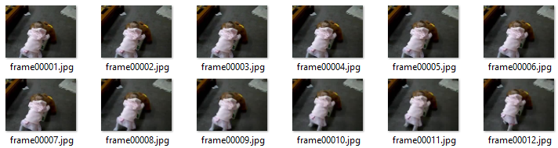
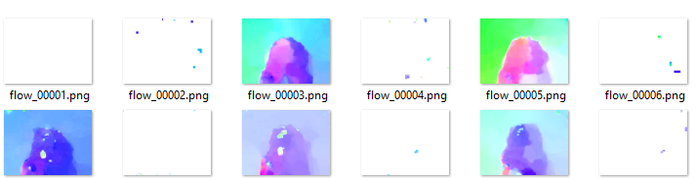
Alternative modality · Comparison
Task 1
Presented by:
Marcos
Team 5
Relative worsening per class with respect to RGB^{W6}
Challenges Limiting Optical Flow Performance
Limited Motion Information
Complex Background Interference
Limited Discriminative Motion
Negative example: push
RGB frames
OF frames
Notes:
Positive Impact on Certain Actions by using Optical Flow
Dynamic Motion Patterns: Classes like jump, cartwheel and punch involved rapid and dynamic motion patterns which are well-captured by optical flow
Spatial-Temporal Relationships: Actions such as turn and eat may involve spatial-temporal relationships that are better represented by optical flow features
Consistency in Motion Direction: Actions that involve consistent motion directions, such as punch or cartwheel, may benefit from optical flow’s ability to highlight directional motion patterns
Challenges Limiting Optical Flow Performance
Limited Motion Information: Classes like ride_bikes, kick_ball and ride_horse may involve continuous and smooth motion patterns where OF may struggle to extract meaningful features
Complex Background Interference: Actions such as catch and push often involve interactions with complex backgrounds or objects and OF might capture background motion leading to noise in the OF features
Limited Discriminative Motion: Certain classes may involve motion patterns that are less distinctive compared to other actions

Slide 9
Multimodal approach · Class score-level fusion
Task 2.1
Presented by:
Marcos
Team 5
Late fusion methodology & results
where:
RGB ∈ {0.0, 0.1, 0.2, …, 0.9, 1.0}
OF = 1 - N
RGB
rgb_1 … rgb_51
RGB prediction
OF
of_1 … of_51
Optical flow prediction
argmax (
mm_1 … mm_51
)
Final prediction
Weights | Only RGB | RGB=0.9 OF=0.1 | RGB=0.8 OF=0.2 | RGB=0.7 OF=0.3 | RGB=0.6 OF=0.4 | RGB=0.5 OF=0.5 | RGB=0.4 OF=0.6 | RGB=0.3 OF=0.7 | RGB=0.2 OF=0.8 | RGB=0.1 OF=0.9 | Only OF
Accuracy | 58.67% | 59.72% | 61.50% | 62.69% | 63.94% | 63.67% | 64.14% | 63.02% | 59.13% | 53.26% | 41.13%
Best combination
Notes:
El millor surt perq potser en aquelles classes on RGB falla, el OF pot donar mes informació

Slide 10
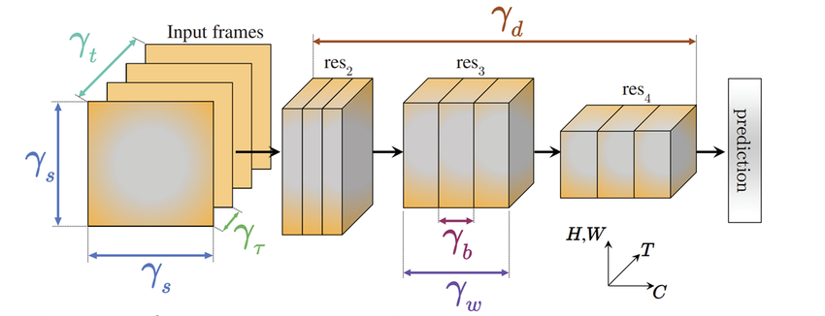
Multimodal approach · Earlier fusion strategy
Task 2.2
Presented by:
Fran
Team 5
Earlier fusion methodology
Input RGB
res₂
res₃
res₄
res₅
RGB Feature vector
pool₅
[1, 2048]
fc₁
conv₅
Freezing F% of layers
X3D S^{[3]} trained with RGB frames without last classification layer
Concat
[1, 4096]
[1, 51]
fc₂
Input OF
res₂
res₃
res₄
res₅
pool₅
[1, 2048]
fc₁
conv₅
OF Feature vector
Freezing F% of layers
X3D S^{[3]} trained with OF frames without last classification layer
[3] Christoph Feichtenhofer, “X3D: Expanding Architectures for Efficient Video Recognition.” https://doi.org/10.48550/arXiv.2004.04730

Slide 11
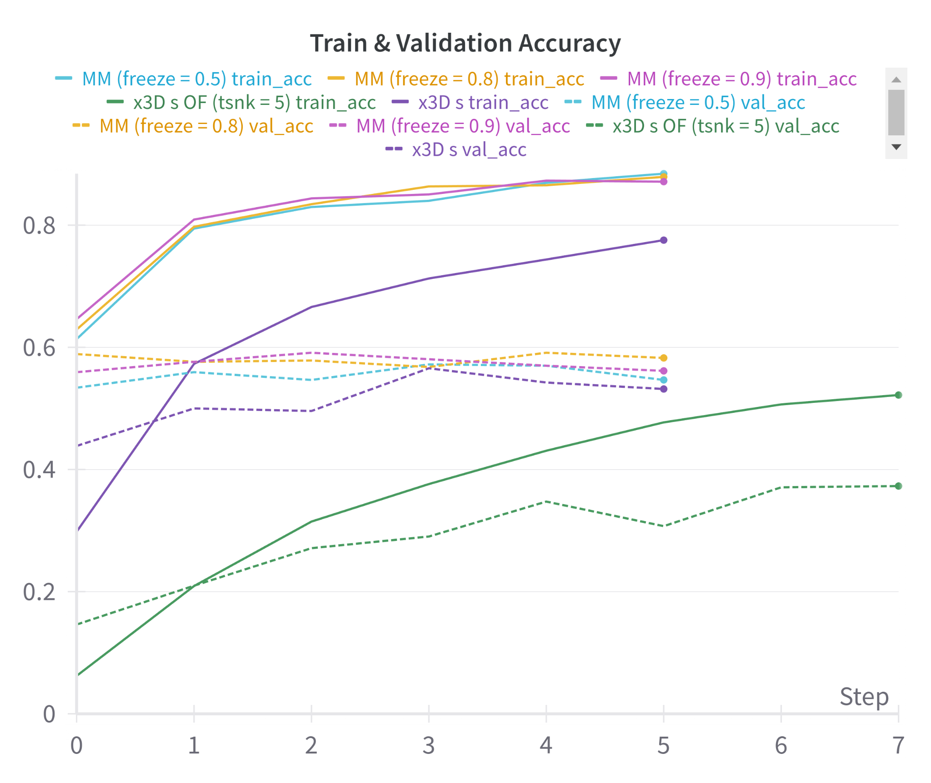
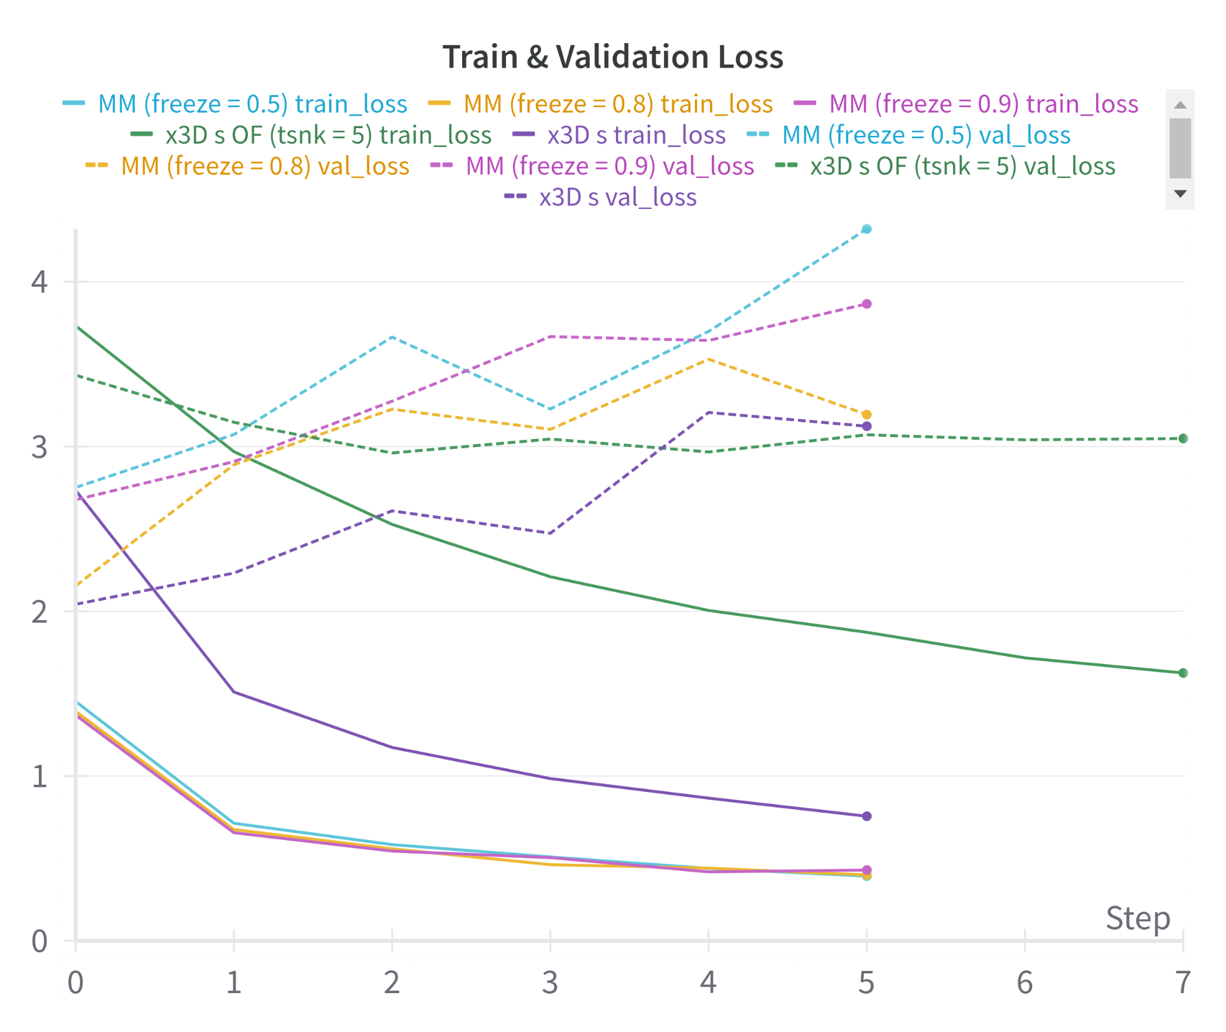
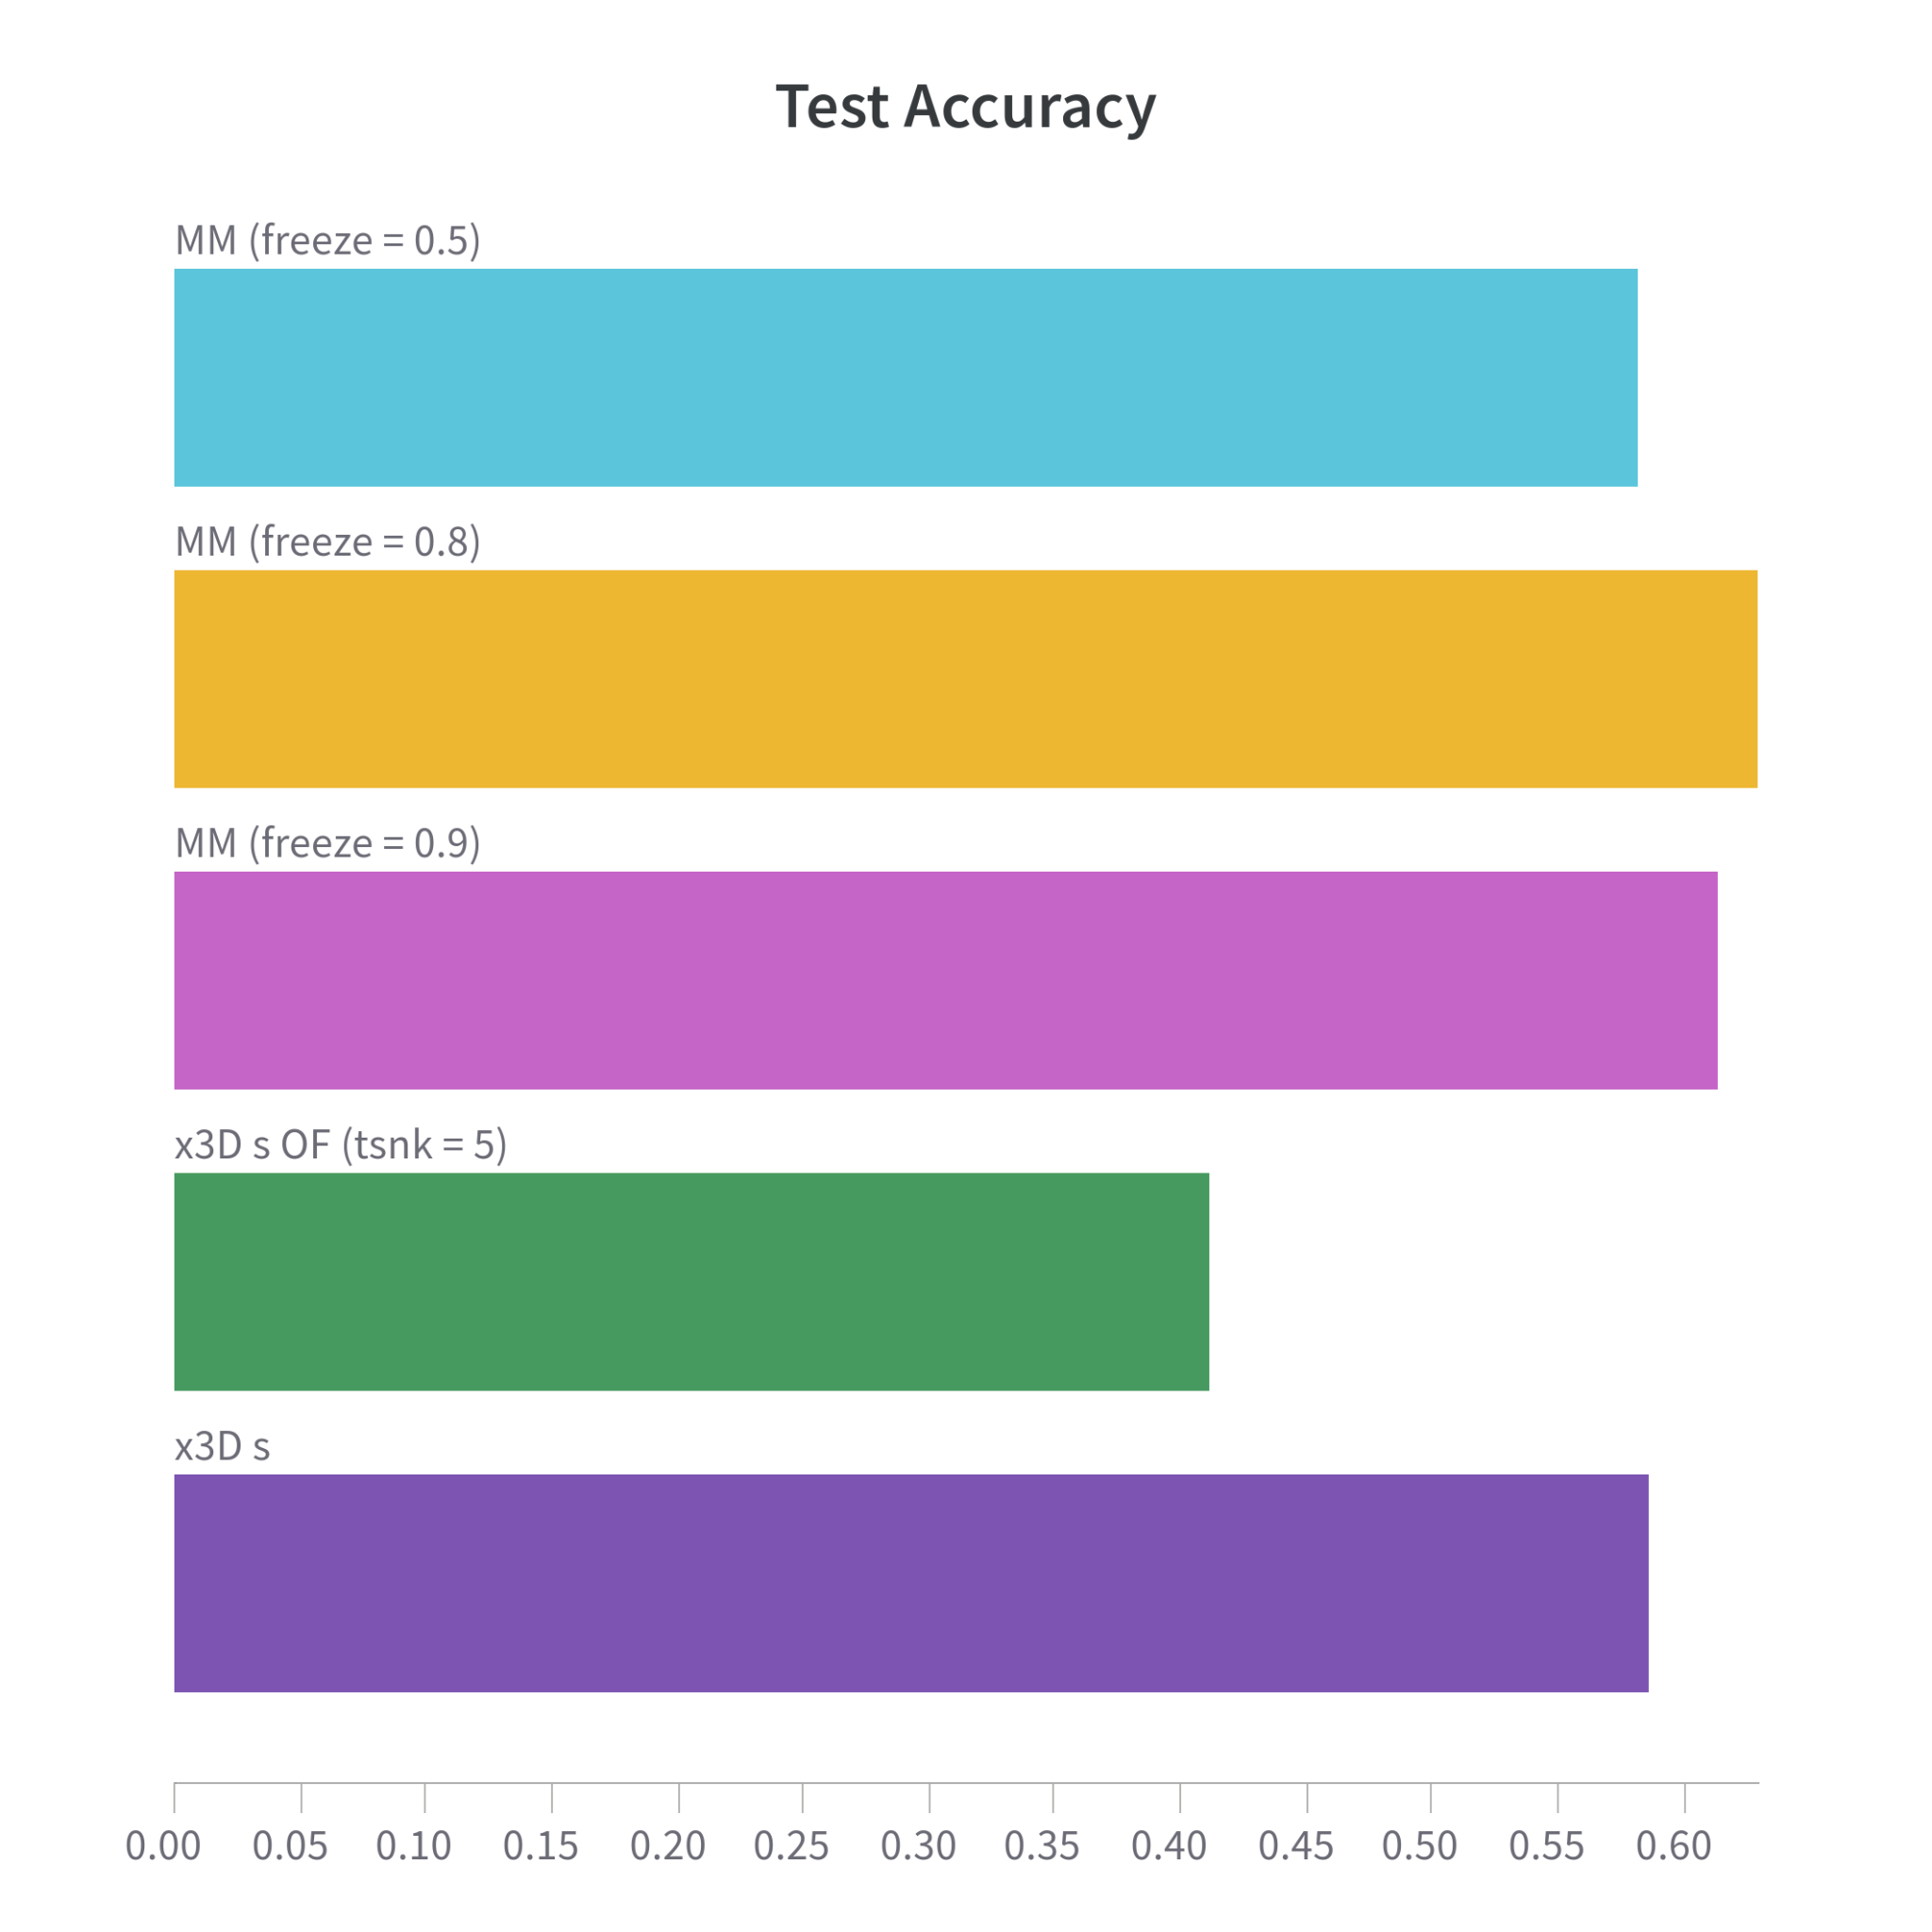
Multimodal approach · Earlier fusion strategy
Task 2.2
Presented by:
Fran
Team 5
Earlier fusion results
0.58
0.63
0.61
0.41
0.59
Discussion:
Freezing 80% and 90% of layers boosts Multimodal model accuracy above OF and RGB baselines. At 50% frozen layers, results mirror the RGB baseline.
Multimodal models exhibit more overfitting, possibly because both branches were already trained with the same data.
X3D S^{[3]} trained with OF frames without last classification layer

Slide 12
Multimodal approach · Comparison
Task 2
Presented by:
Fran
Team 5
Late vs early fusion
Late fusion
Early fusion
No need for re-training.
Easy tweak of the weights.
NNs can be always improved separately.
Unable to learn interactions between the two modalities.
Lower ceiling of improvement.
Room for further improvement.
Further tweaks might allow more complex learning, like using weights for each type of feature vector.
More complex architecture to tune.
Double resources needed in order to train the whole multimodal neural network.
Best test accuracy
64.14%
Best test accuracy
62.95%

Slide 13
Conclusions
Presented by:
Rosana
Team 5
Alternative modality
Among different options, the Optical Flow is a sufficient alternative modality for correctly training a human action recognition model
Optical Flow benefits those actions that are repetitive, characteristic with constant direction. However, it fails in scenarios with complex movements, where RGB images might contain more useful information
Overall, using RBG images results in a better human action recognition performance
Multimodal approach
Late fusion performs slightly better in terms of test accuracy.
However, early fusion can be tested much further and we would expect more complex interactions to give better results.

Slide 14

Thank you for your attention
Questions?
TEAM 5
Marcos Frías · Àngel Herrero · Francisco A. Molina · Rosana Valero

